Slide 1
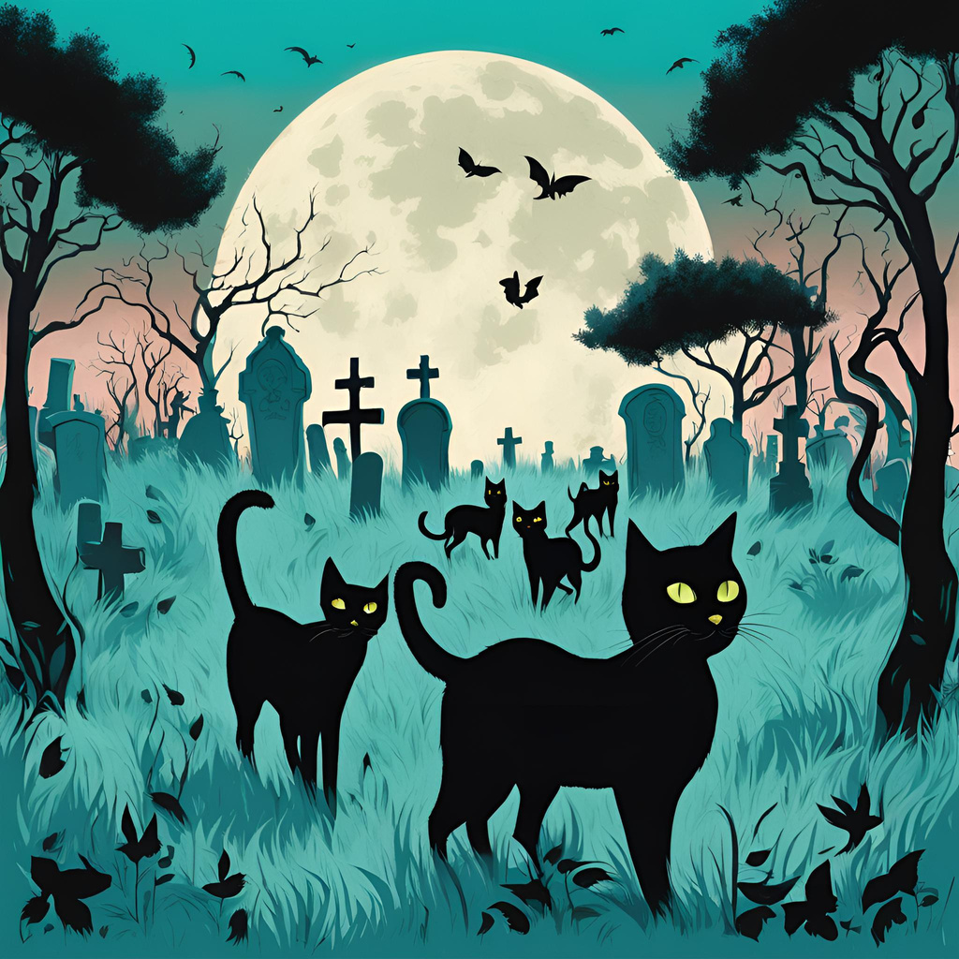
National Black Cat Day
Join us on October 27, 2025 for a celebration and adoption event
Location: The Historic Nashville City Cemetery
Events: There will be a walking tour through the cemetery AND a professional photographer will be on site taking artistic photos of the black cats available for adoption.
sponsored by blackcatsaremisunderstood.com

Slide 2
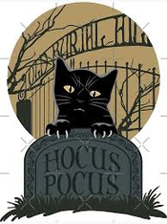
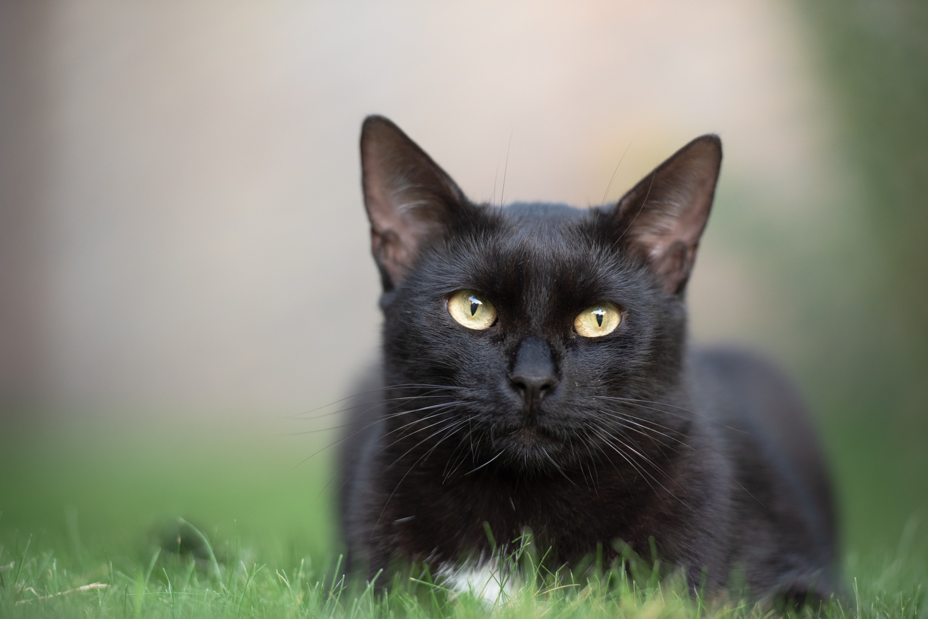
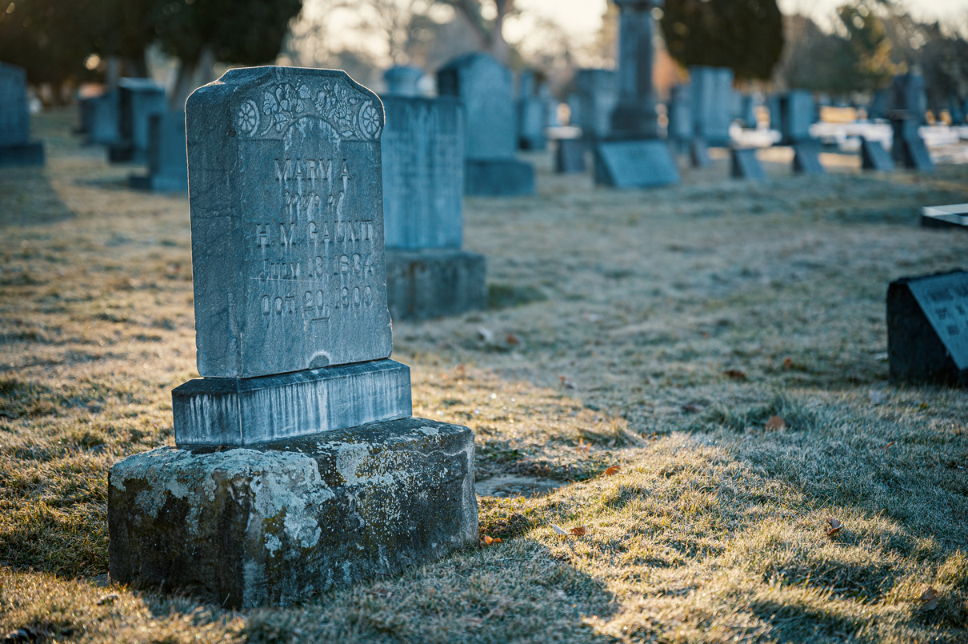
Black cats are often seen as symbols of Halloween, witchcraft, and bad luck, but their association with the ominous runs much deeper. This belief goes back to the Middle Ages when many feared that black cast were witches that had taken on another form. There are many longstanding associations of black cats to cemeteries because of their eerie nature including Thackery Binx from the movie “Hocus Pocus” (1993). To celebrate and raise awareness about black cats, October 27, 2025 is designated as National Black Cat Day. We are proud to partner with the Historic Nashville City Cemetery on this special day to honor these mystical creatures.
Facts About Black Cat Adoption
·A study published in the NIH National Library of Medicine in 2020 found that black cats in shelters have the highest rate of euthanasia (74.6%) and the lowest rate of adoption (10.0%) among all color groups.
·Media images of black cats often fail to capture their personality because of the challenges in the lack of contrast in their coloring. This makes them less appealing than lighter colored cats in online photos publicizing animals available for adoption.
·Black is a common cat color which simply means that there are more black cats available for adoption at a given time.
Schedule of Events
10:00 am – 11:00 am – Arrival and adoptable kitten meet ‘n’ greet
11:00 am – 12:30 pm – Cemetery walking tour – Find a gravestone of one of the 49 people buried on October 27th OR find a gravestone of one of the 13 people buried with a last name of “Black”, “Blackburn”, or Blackman”
12:30 pm – 2:00 pm – Adopt a black kitty and have it professionally photographed by renowned cat photographer Purrcy Kitt

